Slide 1
Fundamental of Software Engineering
Week 3

Slide 2
Process
A process is a series of steps involving activities, constrains and resources that produce an intended output
Activities
Communicate with the customer
Identify the requirements
Check the feasibility
Analyze the requirements
Make a design
Develop the software according to design
Test the developed software
If software is according to the customer and free of errors then implement it otherwise repeat all the steps described above.
Constraints
Requirements should be carefully identified
Feasibility should be checked for the suitability of project in terms of:
Software and hardware requirements
Cost
Time
Problem should be carefully analyzed
Design should be made keeping reusability in mind
Testing should be done carefully
Resources
People
Software
Hardware
Equipment
Time
money

Slide 3
Software Process
Building a software product is actually known as software Process
Fundamental activities for software process
Software Specification
Software Development
Software Validation
Software Evolution

Slide 4
What is a Software Process Model?
Models that prescribe how should development of software progress
Models that describe how is software developed in actuality

Slide 5
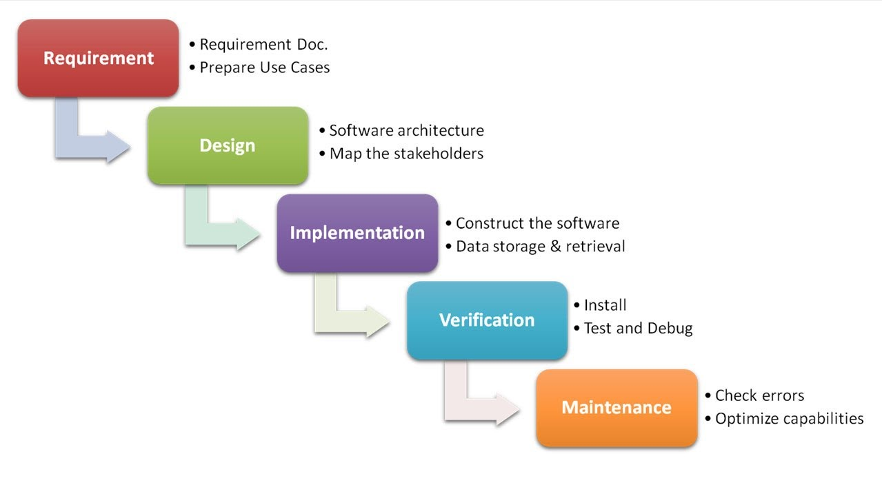
Waterfall Model (Contd.)

Slide 6
Waterfall Model
One of the first process development models proposed
Uncontrolled Software Development Process
No Iterations in WF
Works for well understood problems with minimal or no changes in the requirements
Simple and easy to explain to customers
It presents
a very high-level view of the development process
sequence of process activities
Each major phase is marked by milestones and deliverables (artefacts)

Slide 7
Use cases for the Waterfall SDLC model
This model is used only when the requirements are very well known, clear and fixed.
The requirements are precisely documented
Product definition is stable and well defined
The technologies stack is predefined which makes it not dynamic
No ambiguous requirements
The project is short

Slide 8
Advantages of Waterfall
This model is simple and easy to understand and use.
It is easy to manage due to the rigidity of the model – each phase has specific deliverables and a review process.
In this model phases are processed and completed one at a time. Phases do not overlap.
Waterfall model works well for smaller projects where requirements are clearly defined and very well understood.

Slide 9
Disadvantages of Waterfall
Once an application is in the testing stage, it is very difficult to go back and change something that was not well-thought out in the concept stage.
Not a good model for complex projects. Poor model for long and ongoing projects.
Not suitable for the projects where requirements are at a moderate to high risk of changing. Provides no guidance how to handle changes to products and activities during development (assumes requirements can be frozen)
Views software development as manufacturing process rather than as creative process
There is no iterative activities that lead to creating a final product
Long wait before a final product
Generates lots of documentation

Slide 10
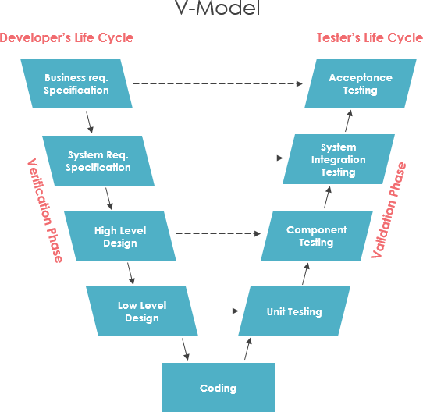
V Model

Slide 11
V Model
A variant of the waterfall model
Uses unit testing to verify procedural design
Uses integration testing to verify architectural (system) design
Uses acceptance testing to validate the requirements
If problems are found during verification and validation, the left side of the V can be re-executed before testing on the right side is re-enacted

Slide 12
Verification and Validation (V&V)
Verification means Are we building the product right?
Verification is the process of checking that a software achieves its goal without any bugs.
It is the process to ensure whether the product that is developed is right or not.
It verifies whether the developed product fulfills the requirements that we have.
Validation means Are we building the right product?
Validation is the process of checking whether the software product is up to the mark or in other words product has high level requirements.
It is the process of checking the validation of product i.e. it checks what we are developing is the right product.
it is validation of actual and expected product.

Slide 13
Use cases for the V-shaped model
This model is used in the medical development field, as it is strictly a disciplined domain
For the projects where an accurate product testing is required
For the small and mid-sized projects, where requirements are strictly predefined
The engineers of the required qualification, especially testers, are within easy reach.
Advantage:
Testing and Verification take place in the early stages

Slide 14
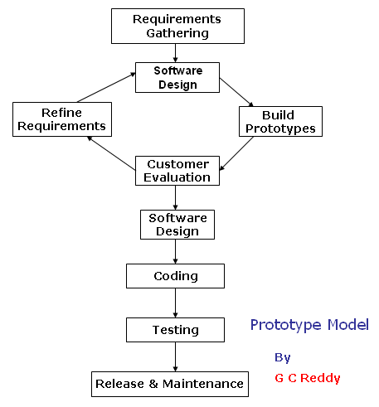
Prototyping Model

Slide 15
PROTOTYPING
A limited representation of a design that allows users to interact with it and to explore its suitability
Allows stakeholders to interact with the envisioned product, gain some experience of using and explore imagined uses
Production of an intermediary product to be used as a basis for testing
Aim is to save on time and money
Aim is to have something that can be tested with real users

Slide 16








PROTOTYPING
You never get it right first time
If at first you don‟t succeed …
prototype
OK?
design
evaluate
done!
re-design

Slide 17
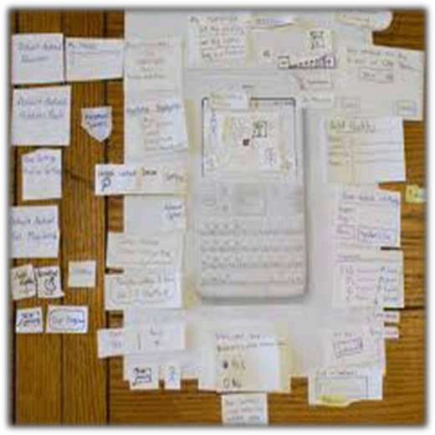
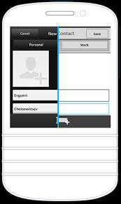

Slide 18
WHAT IS A PROTOTYPE
In interaction design it can be any of the following (and more):
A series of screen sketches
A storyboard, i.e. a cartoon-like series of scenes
A PowerPoint slide show
A video simulating the use of a system
A piece of software with limited functionality written in the target language or in another language

Slide 19
Steps
Build a prototype of the basic functionality, especially the interface
Test the prototype, which will uncover design errors
Correct the errors
Repeat until you have a clean design
11

Slide 20
WHY PROTOTYPE ?
Evaluation and feedback are central to interaction design
Stakeholders can see, hold, interact with a prototype more easily than a document or a drawing
Team members can communicate effectively
You can test out ideas for yourself
It encourages reflection: very important aspect of design
Prototypes answer questions, and support designers in choosing between alternatives

Slide 21
BENEFITS OF PROTOTYPING
Can be used to test every detail of the final product before the product is built
Results in higher user satisfaction
Users are better at evaluating an existing (vs described) system
It brings the users into the process early

Slide 22
Prototyping Model (Contd.)
Features
User involvement?
Smaller projects?
Types:
Evolutionary
Throwaway

Slide 23
THROWAWAY and EVOLUTIONARY Prototypes
Throwaway (or revolutionary) prototypes
are built, tested and thrown away (useful in early stages)
knowledge gained contributes to final system / next prototype
can be expensive
The prototype is used to get the specs right, then discarded!!
Evolutionary prototypes
are not discarded but serve as basis for next iteration of the design
danger of initially bad designs persisting
The prototype eventually becomes the product
31

Slide 24
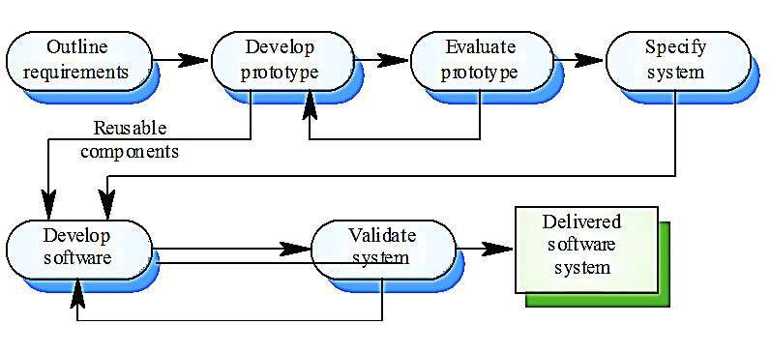
THROW-AWAY PROTOTYPING

Slide 25
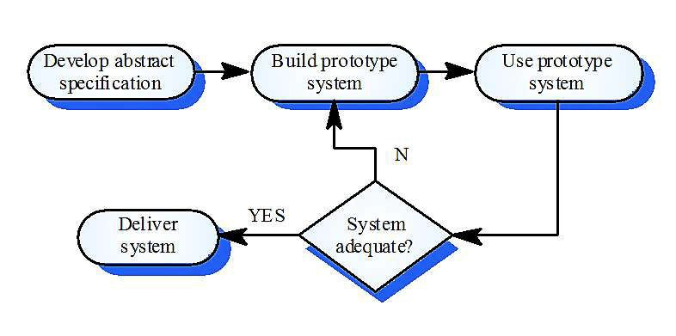
EVOLUTIONARY PROTOTYPING

Slide 26
When to use prototype model
A prototype of the actual product is preferred in situations such as:
user requirements are not complete
technical issues are not clear
Example 1: User requirements are not complete : In any application software like billing in a retail shop, accounting in a firm, etc the users of the software are not clear about the different functionalities required. Once they are provided with the prototype implementation, they can try to use it and find out the missing functionalities.
Example 2: Technical issues are not clear Suppose a project involves writing a compiler and the development team has never written a compiler. In such a case, the team can consider a simple language, try to build a compiler in order to check the issues that arise in the process and resolve them. After successfully building a small compiler (prototype), they would extend it to one that supports a complete language.

Slide 27
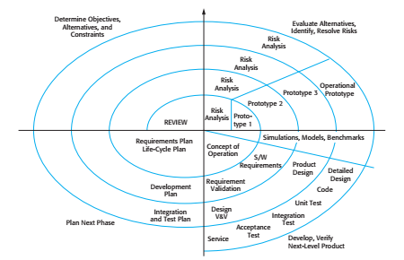
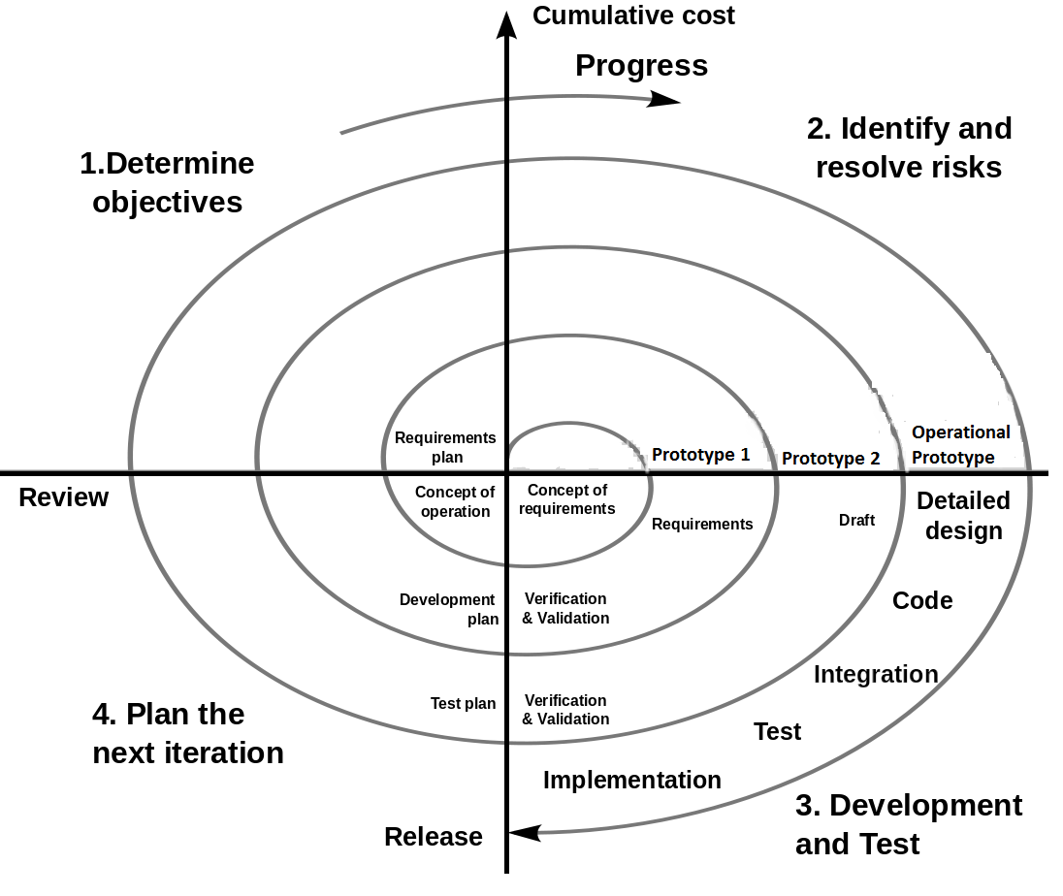
Spiral Model

Slide 28
Spiral Model
The Spiral Development ( or Lifecycle) Model is a systems development method used in information technology.
Developed by Barry Boehm
It combines the features of the prototyping model and the waterfall model.
It is favored for large, expensive, and complicated models.

Slide 29
Steps of the Spiral Model
Define the problem with as much detail as possible by interviewing the client and potential users of the system, as well as, studying any existing system.
A preliminary design is created for the new system.
A first prototype of the new system is constructed from the preliminary design and is a scaled down version of the final product.
4. A second prototype is derived by the following procedure
Evaluate the first prototype for strengths, weaknesses and risks
Define the requirements of the 2nd prototype
Plan and design the 2nd prototype
Construct and test the 2nd prototype

Slide 30
Steps of the Spiral Model
At this point the customer may decide to scrap the whole project if the risk is too high.
Development cost overruns
Operating-cost miscalculation
Other factors that might result in a substandard product
Evaluate the current prototype in the same way as the previous prototype and create another one if needed
Iterate the proceeding steps until the customer is satisfied that the current prototype represents the final product.
Construct the final system
The final system is thoroughly evaluated and tested and routine maintenance is carried out for the life of the product.

Slide 31
When to use Spiral Model
When project is large
When releases are required to be frequent
When creation of a prototype is applicable
When risk and costs evaluation is important
For medium to high-risk projects
When requirements are unclear and complex
When changes may require at any time
When long term project commitment is not feasible due to changes in economic priorities

Slide 32
Advantages
Risk Handling: The projects with many unknown risks that occur as the development proceeds, in that case, Spiral Model is the best development model to follow due to the risk analysis and risk handling at every phase.
Good for large projects: It is recommended to use the Spiral Model in large and complex projects.
Flexibility in Requirements: Change requests in the Requirements at later phase can be incorporated accurately by using this model.
Customer Satisfaction: Customer can see the development of the product at the early phase of the software development and thus, they habituated with the system by using it before completion of the total product.

Slide 33
Disadvantages
Difficulty in time and budget management: As the number of phases is unknown at the start of the project, so time estimation is very difficult. Estimates of budget and time are harder to judge at the beginning of the project since the requirements evolve through the process
Complex: The Spiral Model is much more complex than other SDLC models.
Expensive: Spiral Model is not suitable for small projects as it is expensive.
Too much dependable on Risk Analysis: The successful completion of the project is very much dependent on Risk Analysis. Without very highly experienced expertise, it is going to be a failure to develop a project using this model..

Slide 34
Comparison
Spiral Model
Waterfall model
Risk factors are considered.
The requirements are not freeze.
works in loop.
costly as Risk factor is covered.
Better communication between developer and customer.
Risk factors are not considered.
The requirements are freeze.
Is linear sequential model.
Not much costly.
Communication level is not high

Slide 35
Comparison
Spiral Model
prototype model
Number of phases is fixed.
Requirement are clear but complex.
Customer interaction needs till the prototype is app.
Risk factor are not considered
Number of phases is not fixed.
Used when requirement is not clear and needs conformation
customer interaction continuous to move together.
Risk factor is considered

Slide 36
Phased Development
Cycle time
Time between when requirements document was written and when the system was delivered
Shorter cycle time
Decomposed system
System delivered in pieces
enables customers to have some functionality while the rest is being developed
Two systems functioning in parallel
the production system (release n): currently being used
the development system (release n+1): the next version

Slide 37
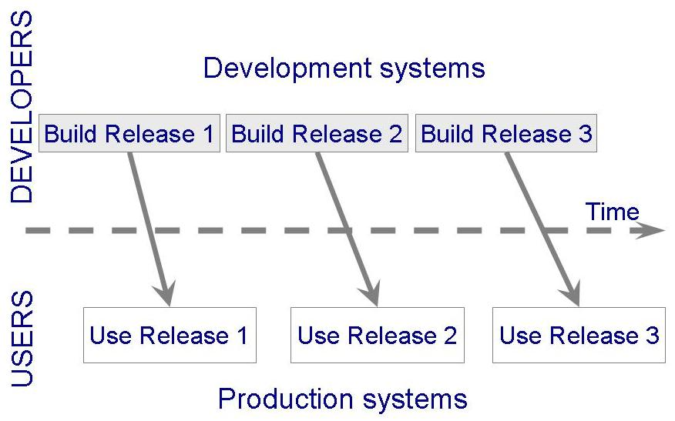
Phased Development (Contd.)

Slide 38
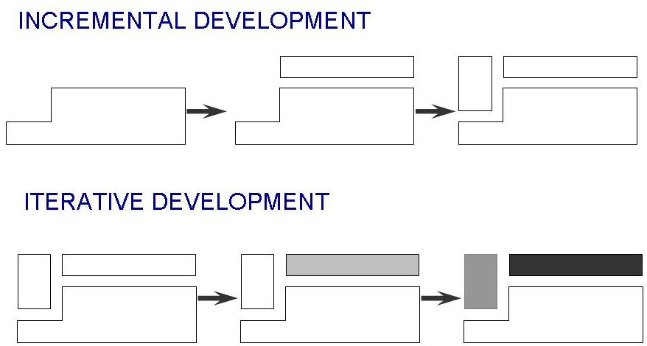
Phased Development (Contd.)
Incremental development: starts with small functional subsystem and adds functionality with each new release
Incremental development develops an initial implementation, exposes this to user comment, and evolves through several versions

Slide 39
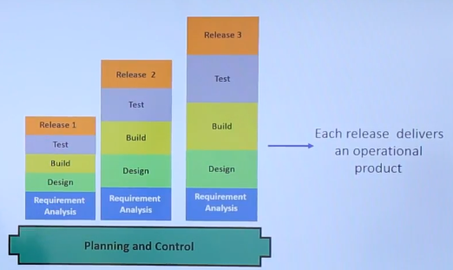
Incremental Dev. (Contd…)

Slide 40
Incremental Dev. (Contd…)
In incremental High risk and major functionalities are build first.
Each Release Deliver and operational Product so client can use it.
Requires definition of complete and functional system early to define increments
When to use:
When staffing is not available for complete implementation by business deadline.
Most of requirements are known upfront but expected to evolve over time
Need to get basic functionality to the market early
On Projects with new technology and have lengthy development schedules
Notes:
Risk= Cause of failure

Slide 41
Phased Development (Contd.)
Iterative development: starts with full system, then changes functionality of each subsystem with each new release. In iterative model the organization start with some of the software specification and develop the first version of the software. After the first version if there is a need to change the software then a new version of the software is created with a new iteration. It will repeat until deployment of the software.
Iterative development is a way of breaking down the software development of a large application into smaller chunks. In iterative development, feature code is designed, developed and tested in repeated cycles. With each iteration, additional features can be designed, developed and tested until there is a fully functional software application ready to be deployed to customers.

Slide 42
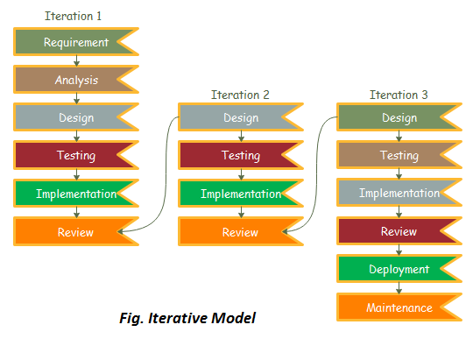
Iterative Model
Notes:
This process and iterations continues until we get the complete required software

Slide 43
Iterative Development (Contd.)
Advantages of Iterative model:
Generates working software quickly and early during the software life cycle.
Easier to test and debug during a smaller iteration.
Each iteration can be easily managed.
Disadvantages of Iterative model:
It is not suitable for smaller projects.
It is not suitable for changing major requirements.
Notes:
Slight requirements can be changed but not the major requirements. Like if client ask you to develop a 2 wheeler vehicle when you design it and he asked to change it to 4 wheeler vehicle.

Slide 44
Software validation
Unit Testing: The components making up the system are tested by the people developing the system. Each component is tested independently, without other system components
Integration Testing: The components making up the system are tested by the people developing the system after integration.
System Testing: System components are integrated to create a complete system. This process is concerned with finding errors that result from unanticipated interactions between components and component interface problems. It is also concerned with showing that the system meets its functional and non-functional requirements, and testing the emergent system properties.
Acceptance testing: This is the final stage in the testing process before the system is accepted for operational use. The system is tested with data supplied by the system customer rather than with simulated test data. Acceptance testing may reveal errors and omissions in the system requirements definition, because the real data exercise the system in different ways from the test data. Acceptance testing may also reveal requirements problems where the system’s facilities do not really meet the user’s needs or the system performance is unacceptable.

Slide 45
Software evolution
Coping with change :
Change is inevitable in all large software projects. The system requirements change as the business procuring the system responds to external pressures and management priorities change. As new technologies become available, new design and implementation possibilities emerge. Therefore whatever software process model is used, it is essential that it can accommodate changes to the software being developed.
Change avoidance : prototyping model
Change tolerance : incremental model

Slide 46
Activity
Giving reasons for your answer based on the type of system being developed, suggest the most appropriate software process model that might be used as a basis for managing the development of the following systems:
A system to control anti-lock braking in a car
A virtual reality system to support software maintenance
A university accounting system that replaces an existing system
An interactive travel planning system that helps users plan journeys with the lowest environmental impact
Certified Carriers is a courier company that has decided to automate its billing, customer service, and inventory systems due to an increase in their sales volume and customer strength.
The company has no experience in automation because this is for the first time that they are planning for automating their basic services.
The client too has no idea about the size, cost, and the duration of the project.
They have assigned the automation project to Technology Systems.
Technology Systems needs to analyze the systems of Certified Carriers and present a prospective: working model of the software product.
Only after the working model is approved and signed-off by Certified Carrier, will the team draw up a specific project plan and create a development team.
However, an analysis team is formed to create the working model, arrange meetings with the client, accept feedback, and implement all practicable feedback to the working model.
The team at Technology Systems intends to reuse the technology and the working model to further develop and complete the creation of the software product.

